Slide 1
William Stallings
Computer Organization and Architecture
7th Edition
Superscalar Processors, Superpipelined Processors and Multicore Systems

Slide 2
What is Superscalar?
Common instructions (arithmetic, load/store, conditional branch) can be initiated simultaneously and executed independently

Slide 3
Why Superscalar?
Most operations are on scalar quantities
Improve these operations by executing them concurrently in multiple pipelines
Requires multiple functional units
Requires re-arrangement of instructions

Slide 4
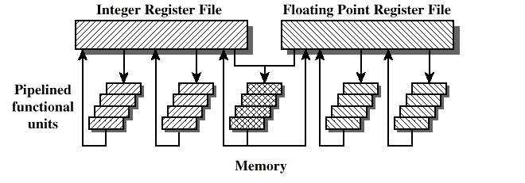
General Superscalar Organization
2ddd

Slide 5
Superpipelined
Many pipeline stages need less than half a clock cycle
Double internal clock speed gets two tasks per external clock cycle
Superscalar allows parallel fetch and execute

Slide 6
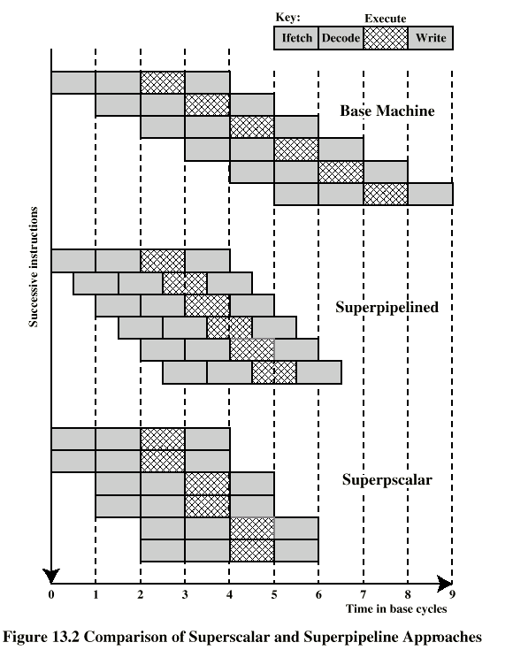
Superscalar vs Superpipelined

Slide 7
Limitations
Instruction level parallelism: the degree to which the instructions can be executed parallel (in theory)
To achieve it:
  Compiler based optimisation
  Hardware techniques
Limited by
  Data dependency
  Procedural dependency
  Resource conflicts

Slide 8
True Data (Write-Read) Dependency
ADD r1, r2 (r1 <- r1 + r2)
MOVE r3, r1 (r3 <- r1)
Can fetch and decode second instruction in parallel with first
Can NOT execute second instruction until first is finished

Slide 9
Procedural Dependency
Cannot execute instructions after a (conditional) branch in parallel with instructions before a branch
Also, if instruction length is not fixed, instructions have to be decoded to find out how many fetches are needed
This prevents simultaneous fetches

Slide 10
Resource Conflict
Two or more instructions requiring access to the same resource at the same time
  e.g. functional units, registers, bus,memories
Similar to true data dependency, but it is possible to duplicate resources

Slide 11
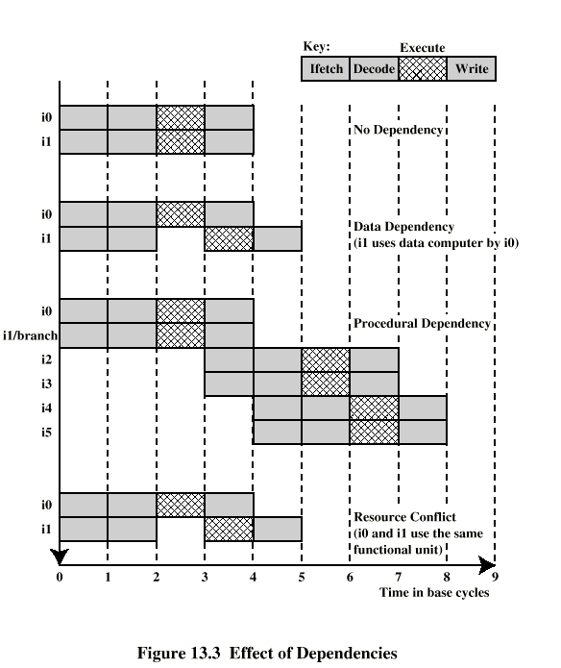
Effect of
Dependencies

Slide 12
Multicore Computers
Combines two or more processors on a single piece of silicon
Each core consists of registers, ALU, pipeline hardware and control unit plus L1 instruction and data caches
Also L2 cache and L3 cache

Slide 13
Multicore Organization
The number of core processors on the chip
The number of levels of cache memory
The amount of cache memory that is shared

Slide 14
